Slide 1
Media Queries and Keyframe Animations
Week 8

Slide 2
Media queries

Slide 3
Why media queries?

Slide 4
We can design how the document is presented across different medias

Slide 5
Is it extra to talk about medias for a web page?
Since it is just a web page for screens… or really?

Slide 6
screen for computer screens
print for printed documents
speech for speech synthesizers
… and more

Slide 7
Where to place media queries?
Options 1
We can write it inside our CSS files
html {
font-size: 16px;
}
@media screen and (max-width: 600px) {
html {
font-size: 14px;
}
}
@media is a special directive in CSS that matches media queries

Slide 8
Where to place media queries?
Options 2
We can specify media query when linking CSS file in HTML (it’s easier for option 1 though!)
<link rel="stylesheet" media="screen and (max-width: 600px)" href="assets/screen.css">
Notes:
Not recommended

Slide 9
Option 1 -- just CSS with extra steps
@media (max-width: 375px) and (max-height: 667px) {
html {
background: red;
}
}
“For screens that have a width < 375 pixels and a length < 667 pixels, use these CSS properties in addition to the ones above.”

Slide 10
Breakdown
@media not|only mediatype and (expressions) { // CSS Code }
Our General Layout

Slide 11
Breakdown
@media not|only mediatype and (expressions) { // CSS Code }
Header -- this one tells CSS , ‘Hey I’m declaring some special rules depending on what our device sizes are’

Slide 12
Breakdown
@media not|only mediatype and (expressions) { // CSS Code }
Conditional (optional) -- declare not for these styles apply for everything except the specified resolution. It is set to only by default.

Slide 13
Breakdown
@media not|only mediatype and (expressions) { // CSS Code }
Media Type (optional) -- can be print, screen, or speech, default is ‘all’

Slide 14
Breakdown
@media not|only mediatype and (expressions) { // CSS Code }
Expressions - how we define what states the CSS should apply to -- media queries can add or override previous code!

Slide 15
Expressions
Range media features
You can specify a range of values (using min-/max-prefix)
width, height, device-width, device-height
…
Discrete media features
There are only a few predefined values for a feature
orientation
…

Slide 16
Most Commonly Used
width, height,
min-width, max-width, etc

Slide 17
Say you would like to match all computer screens no larger than 600px?
screen and (max-width: 600px)
Make it longer by adding more… and

Slide 18
To match all screens between 200px and 400px in width?
screen and (min-width: 200px) and (max-width: 400px)

Slide 19
To match the size of an iPad device (the very original one)?
screen and (device-width: 768px) and (device-height: 1024px)

Slide 20
Say you would like to match all no larger than 600px?
all and (max-width: 600px)

Slide 21
Negate by the media query by prepending… not
not all and (max-width: 500px)
What does this mean?

Slide 22
Demo
tinyurl.com/wdd-mqu

Slide 23
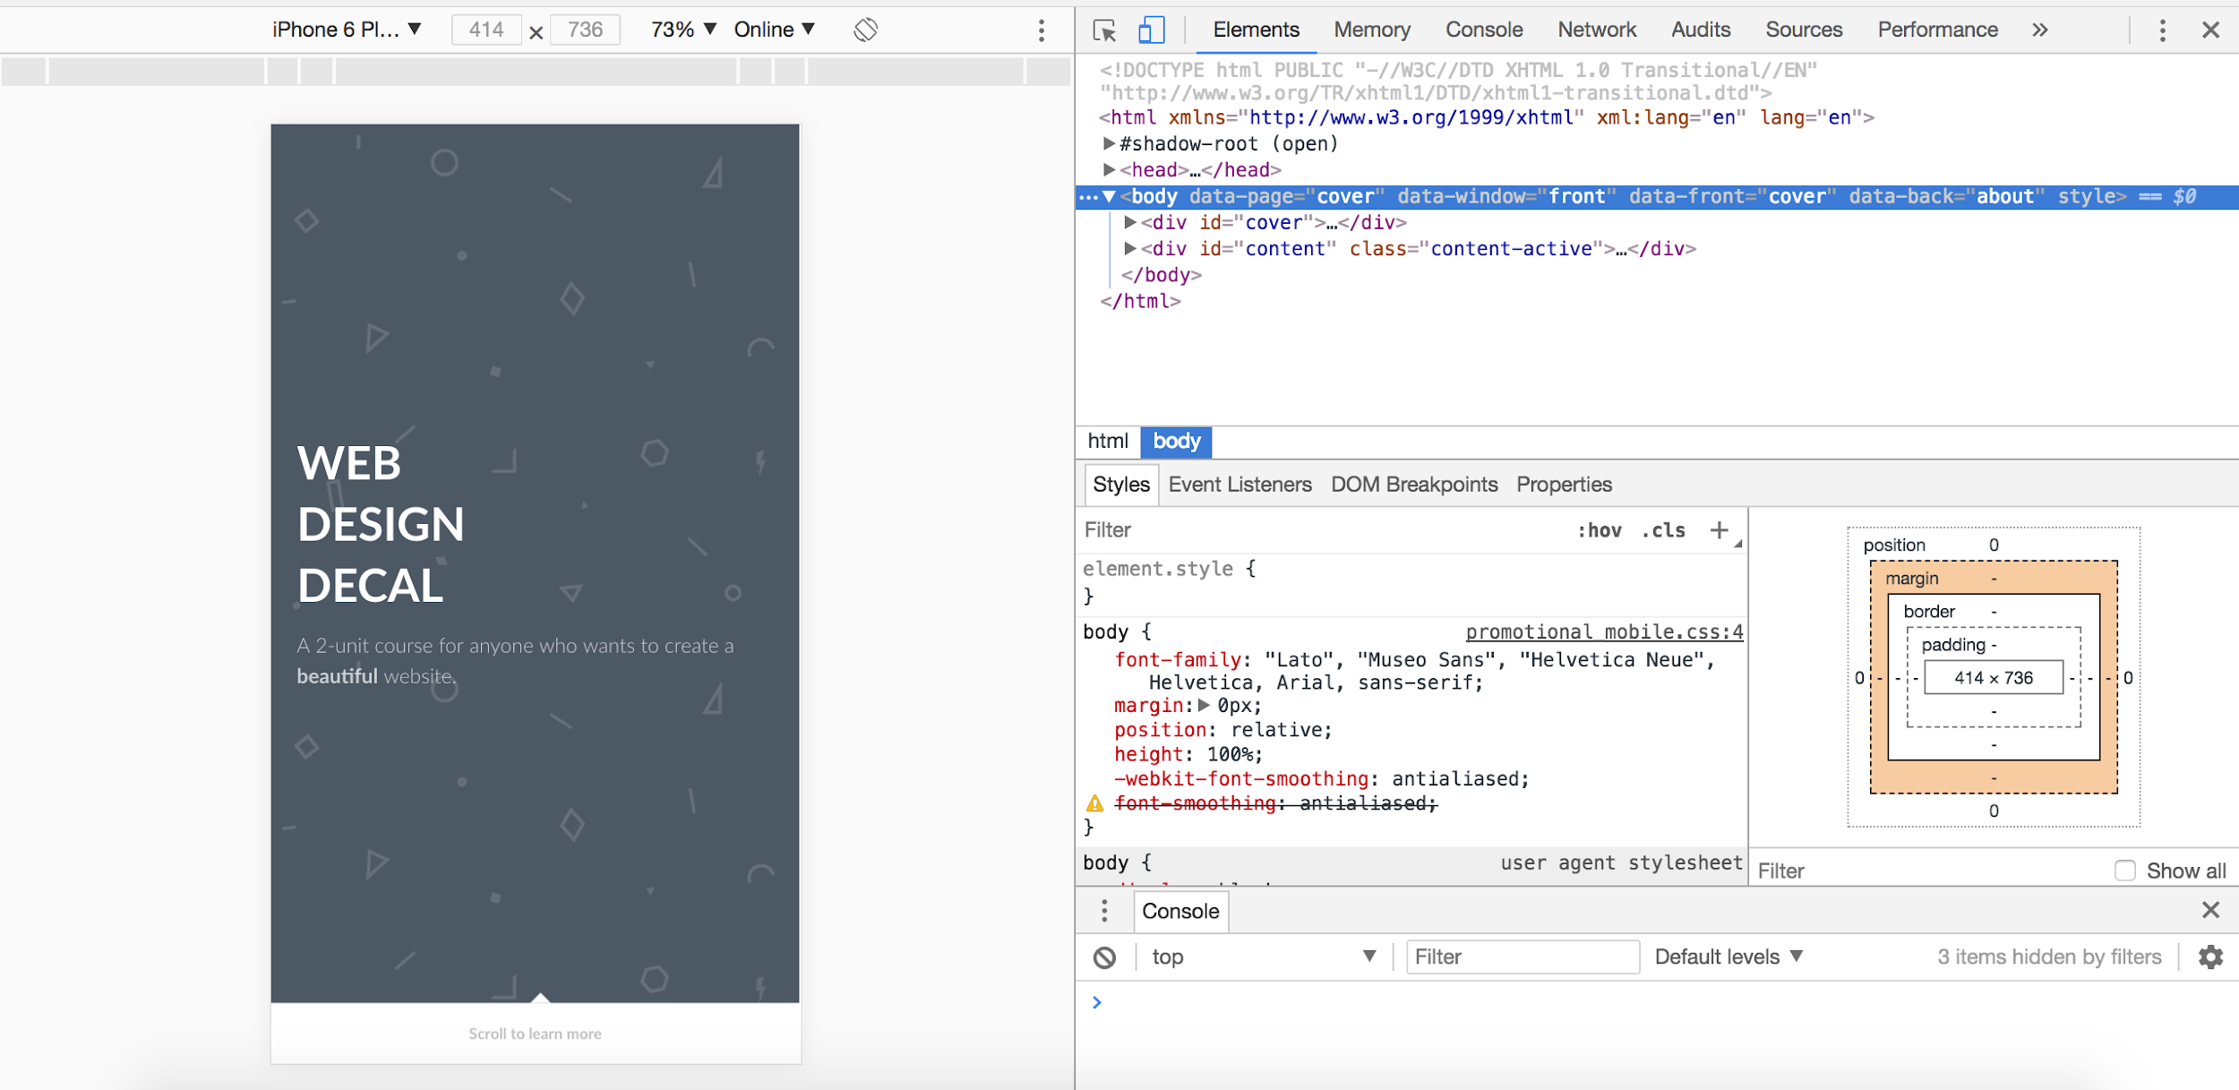
Why web inspector is so great -- see what your website looks like on different devices.

Slide 24
For more info Media Queries Level 4
Also, flex and grid
Check out flex-wrap & grid layouts

Slide 25
Not many visuals b/c it’s hard to find good examples on dribbble :( but ya know what sites have good media responsiveness

Slide 26

Example site of good media query usage #ad
hex.innovativedesign.club
I’m a slut for good plugs
did you know? we’re not a part of innovative design lol

Slide 27
Keyframe animations

Slide 28
With animations, we can create really nice, dynamic websites.

Slide 29
Effectively allowing to express our brands or identities in ways we haven’t before.

Slide 30
Animation - a change of state over time
What is our starting state? What is our ending state?

Slide 31
Most of which, can be done in CSS.

Slide 32
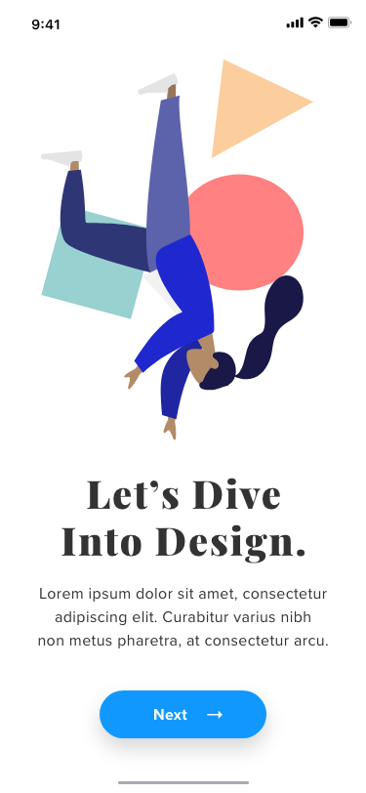
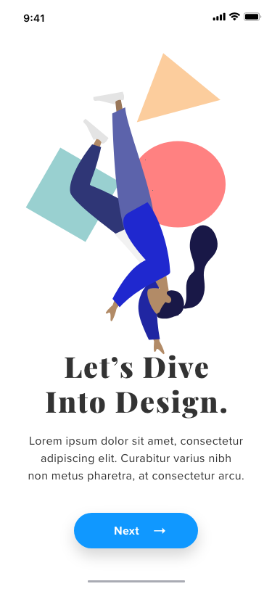
Start: 0%
End: 100%
Mid: 50%
Notice the differences -- don’t worry about what’s in between

Slide 33
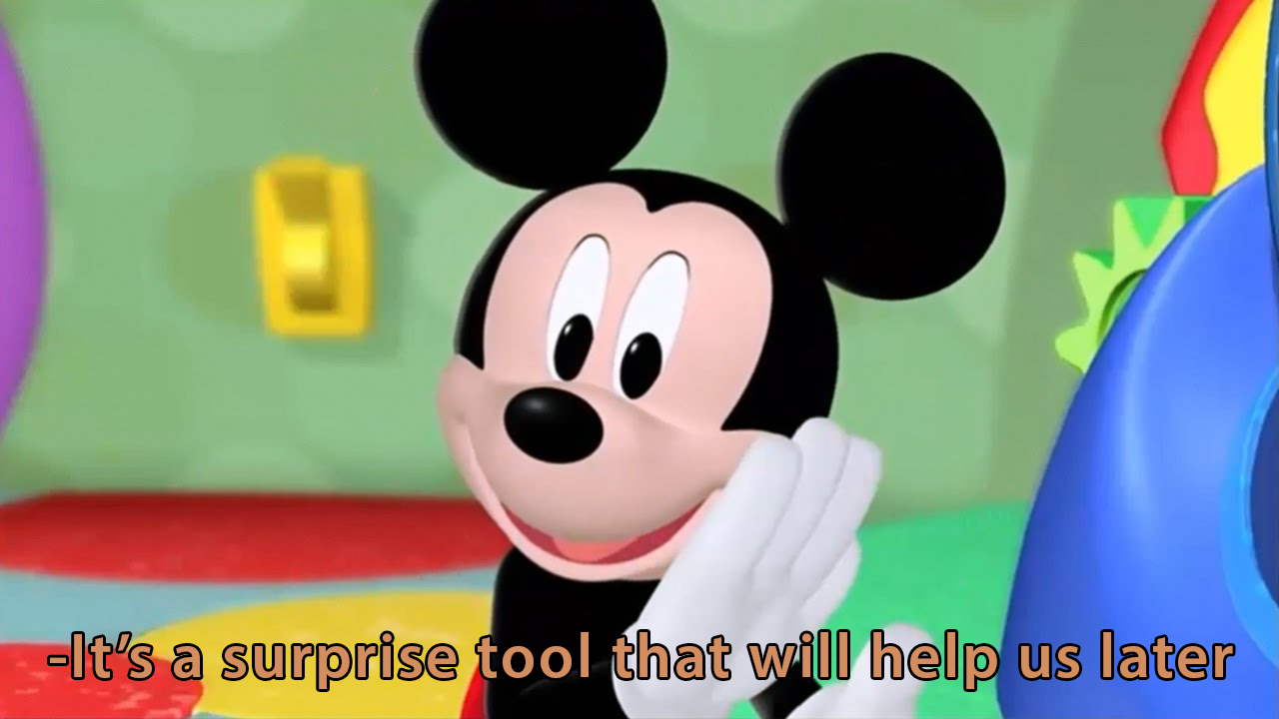
@keyframes
Similar to the @media name
Format: @keyframes name {rules}
Rules: what to do during animation
Defining animation to use later
@keyframes name {
rules
}

Slide 34
Writing rules
Using from and to
Using percentages [0 - 100]
@keyframes fadeIn {
from { opacity: 0; }
to { opacity: 1; }
}

Slide 35
Writing rules
Using from and to
Using percentages [0 - 100]
@keyframes fadeInOut {
0% { opacity: 0; }
50% { opacity: 1; }
100% { opacity: 0; }
}

Slide 36
Writing rules: another example
Using from and to
Using percentages [0 - 100]
@keyframes upDown {
0% { top: 100px; }
50% { top: 0px; }
100% { top: 100px; }
}

Slide 37
Application

Slide 38
Using your keyframe
Put it in the element of choice
Use the name you chose
Add optional adjustments
@keyframes upDown {
0% { top: 100px; }
50% { top: 0px; }
100% { top: 100px; }
}
#potato-head {
animation-name: upDown;
}

Slide 39
Optional adjustments???
Duration
Speed curve
Delay
Play #
Direction
#potato-head {
animation-name: upDown
animation-duration: 0.5s;
animation-timing-function: ease-in;
animation-delay: 0s;
animation-iteration-count: 2;
animation-direction: reverse;
}

Slide 40
Optional adjustments???
Duration
Speed curve
Delay
Play #
Direction
#potato-head {
animation-name: upDown
animation-duration: 0.5s;
animation-timing-function: ease-in;
animation-delay: 0s;
animation-iteration-count: 2;
animation-direction: reverse;
}

Slide 41
Optional adjustments???
Duration
Speed curve
Delay
Play #
Direction
#potato-head {
animation-name: upDown
animation-duration: 0.5s;
animation-timing-function: ease-in;
animation-delay: 0s;
animation-iteration-count: 2;
animation-direction: reverse;
}

Slide 42
Optional adjustments???
Duration
Speed curve
Delay
Play #
Direction
#potato-head {
animation-name: upDown
animation-duration: 0.5s;
animation-timing-function: ease-in;
animation-delay: 0s;
animation-iteration-count: 2;
animation-direction: reverse;
}

Slide 43
Optional adjustments???
Duration
Speed curve
Delay
Play #
Direction
#potato-head {
animation-name: upDown
animation-duration: 0.5s;
animation-timing-function: ease-in;
animation-delay: 0s;
animation-iteration-count: 2;
animation-direction: reverse;
}

Slide 44
Animation shorthand
In this order:
Name
Duration
Speed curve
Delay
Play #
Direction
#potato-head {
animation: upDown 0.5s ease-in 0s 2 reverse;
}

Slide 45
Stop in final state
Use special property to stop animation in a specific final state
#potato-head {
animation: upDown 0.5s ease-in 0s 2 reverse;
animation-fill-mode: forwards;
}

Slide 46
Demo
tinyurl.com/keyframe-wdd
Solutions: tinyurl.com/keyframe-sol

Slide 47
Transitions:
Pseudo-selectors
Animations:
Keyframes
Responding to a user’s action
Use transition property to determine time, speed curve, and pseudo-selector to determine states
Example
div:hover { rules }
Continuous and automatically instigated animations
Does not depend on user states, more control over animation and timeframes
Example
div { animation: name }
@keyframe name { rules }

Slide 48
Project Spec
After consulting with staff, this semester, we have two solo projects instead of one final project. We will be splitting the grade between the final project (40%) into proj2 (20%) and proj3 (20%).

Slide 49
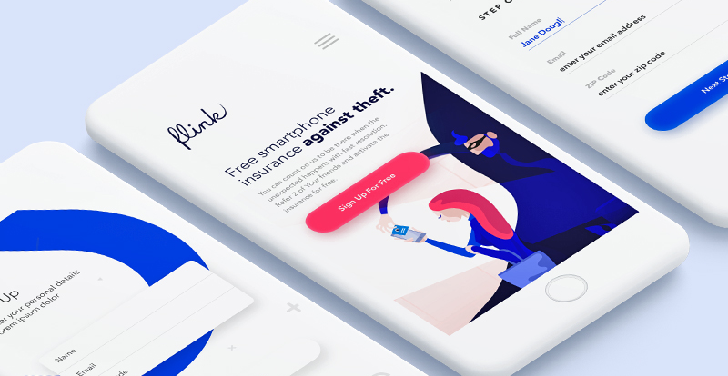
Project: Mobile First Design
Redesign a business website of your choice.
Minimum 6 screens, including the home screen.
Use 5 distinct keyframe animations and media queries to support the following screens:
1920px by 1080
1168 x 560px
375px by 580px
Due in 2 weeks April 15th
Will hold extra OH during this time! Come visit us!

Slide 50
Project Spec
Check it out here:
Attendance: sodales
tinyurl.com/wdd-spec

